Slide 1
Digital Portfolio
STUDENT NAME: SHAAFIYA HATHEEJA . J
REGISTER no AND NMID: 24134131802522018 and asanm41341324214018
Nmid:1C15A734028E72AACD7496637142C9B3
DEPARTMENT: II-BSC(CS)
COLLEGE:DEEN COLLEGE OF ARTS AND SCIENCE

Slide 2
PROJECT TITLe
STUDENT DIGITAL PORTFOLIO

Slide 3
AGENDA:
1.Problem Statement
2.Project Overview
3.End Users
4.Tools and Technologies
5.Portfolio design and Layout
6.Features and Functionality
7.Results and Screenshots
8.Conclusion
9.Github Link

Slide 4
PROBLEM STATEMENT
The problem statement defines the need to develop a responsive and interactive portfolio website for a student. It focuses on creating a platform to present personal details, education, projects, skills, and contact information in a structured, user-friendly, and visually appealing manner, with added features like smooth navigation, dark mode, and a functional contact form

Slide 5
PROJECT OVERVIEW
The Project Overview of the Student Digital Portfolio describes the purpose, structure, and features of the website. It is a responsive and interactive portfolio created using HTML, CSS, and JavaScript, designed to present a student’s personal details, academic background, projects, skills, and contact information in an organized, visually appealing, and user-friendly manner.

Slide 6
WHO ARE THE END USERS?
The Student Digital Portfolio is a responsive and interactive personal website developed using HTML, CSS, and JavaScript. It is designed to showcase a student’s profile, academic details, skills, projects, and contact information in an organized and visually appealing format.
End Users:
Students – to create and share their portfolio for academics, internships, or job applications.
Recruiters and Employers – to review a student’s skills, projects, and contact details.
Teachers or Mentors – to assess and guide students based on their showcased work.
Peers or Collaborators – to connect and collaborate on projects or learning activities.

Slide 7
TOOLS AND TECHNIQUES
Tools:
HTML (HyperText Markup Language) The standard language used to create and structure the content of the website.
CSS (Cascading Style Sheets) Used for styling and designing the website to make it attractive and responsive.
JavaScript Adds interactivity such as smooth scrolling, dark mode toggle, and form validation.
Techniques:
Smooth Scrolling : Provides seamless navigation between sections of the page.
Form Validation : Checks input fields to ensure proper data entry before submitting the form.
UI/UX Design Principles : Focuses on creating a user-friendly and visually appealing interface.

Slide 8
POTFOLIO DESIGN AND LAYOUT
Portfolio design:
Profile – Photo, name, and a short introduction.
Education – Academic qualifications and years of study.
Projects – A gallery of projects with images and descriptions.
Skills – A visually appealing list of technical skills.
Layout of the Program:
Header
Fixed navigation bar with links to sections: Dark mode toggle button.
Home Section
Circular profile image
Student’s name and short description
Education Section
Clean list format with degree details and timeline.

Slide 9
FEATURES AND FUNCTIONALITY
Features :
Responsive Design – Works on desktops, tablets, and mobile devices.
Smooth Scrolling – Easy navigation between different sections of the page.
Dark Mode Toggle – Switch between light and dark themes for better user experience.
Functionalities :
Profile Display – Shows student name, image, and introduction.
Education Section – Lists academic details like degrees, institutions, and years.
Projects Section – Displays project cards with images and descriptions.

Slide 10
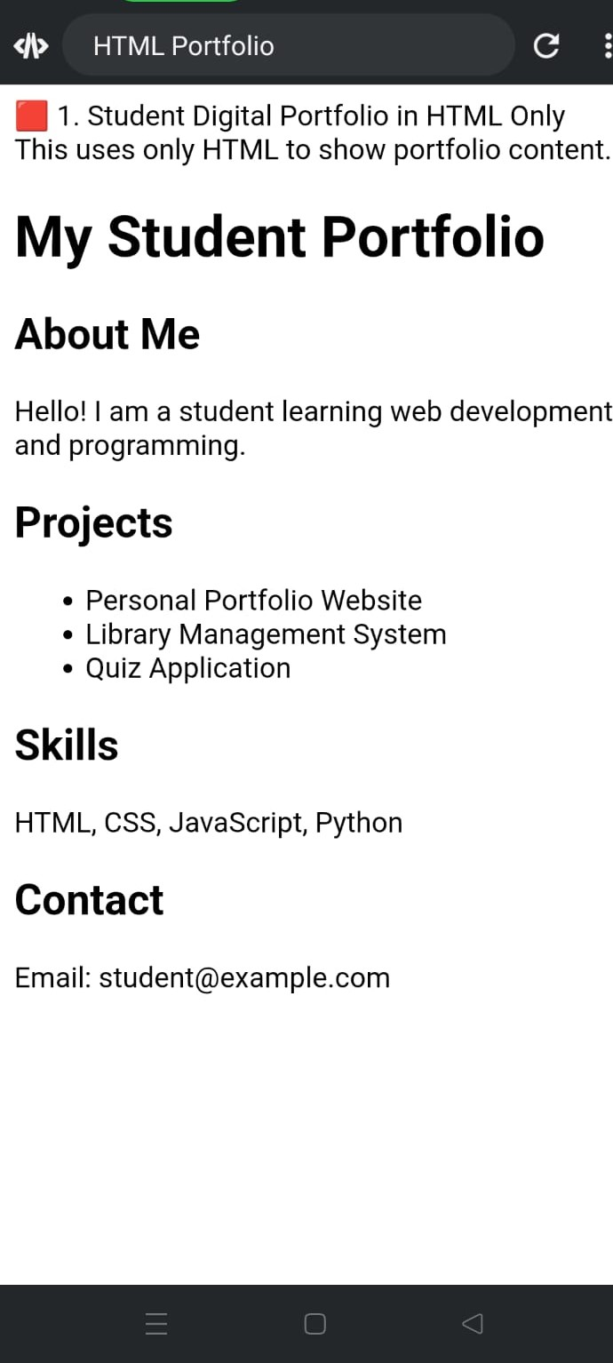
RESULTS AND SCREENSHOTS

Slide 11
CONCLUSION
The Student Digital Portfolio effectively showcases a student’s profile, education, skills, and projects in a modern, responsive, and interactive website. With features like smooth navigation, dark mode, and a functional contact form, it provides an engaging user experience and serves as a professional platform for students to present their achievements and skills online.

Slide 12
GITHUB LINK
https://github.com/dccs24shaafiya-oss/Shaafiya-hatheeja.j-TNSDC-FWD-DP.git

